Slide 1
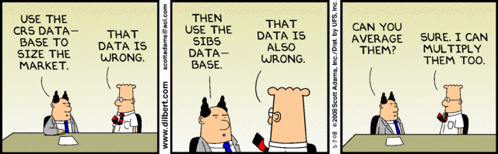

Slide 2
On-Line Analytical Processing
Rasmus Pagh
Reading: RG25, [WOS04, sec. 1+2]

Slide 3
Today’s lecture
Multi-dimensional data and OLAP.
Bitmap indexing.
Pre-aggregation and materialized views.

Slide 4
Background
Data = gold mine!
  Data can identify useful patterns that can be used to form a proper business strategy.
Two main approaches:
  Data mining: Automated ”mining” of patterns. (In two weeks.)
  OLAP: Interactive investigation of data. (This lecture.)
OLAP = On-Line Analytic Processing
OLTP = On-Line Transaction Processing

Slide 5
Data Warehouse
Data warehouse: Integrated collection of data used in support of decision-making processes.
Typical characteristics:
  Records data over time (not just “current”).
  Snapshot of the operational data.
  Can be organized as collection of ”data marts”.
Challenges: Data integration, cleaning…
Much more about this next week!

Slide 6

Multi-dimensional data model
Tuples with d attributes can be viewed as points in a d-dimensional ”cube”.
Value of
attrib. 1
Value of
attrib. 2 Value of
attrib. 3

Slide 7
Multi-dimensional data model
Example: (BIDD,’John Doe’,12) can be viewed as the point with coordinates
  BIDD
  John Doe
  12
along the dimensions
  Course
  Name
  Grade
Dimensions often have granularities (e.g. study line BSWU, class of 2013)

Slide 8
Terminology
Fact = point in the cube
Measure = number associated with facts, can be aggregated
  Examples: Sales price, customer debit, time to next click.
Dimension = feature that can be used to select subset of facts.
  Examples: ID of sales person, name of shop, state of shop,…

Slide 9
Typical OLAP query
Selection on one or more dimensions
  e.g. select sales of one customer group.
Grouping by one or more dimensions
  e.g., group sales by quarter.
Aggregation over each group
  e.g. total sales revenue.
Terminology for ”navigating” data by modifying the query:
  Roll-up, drill-down, slicing, dicing, pivoting.

Slide 10
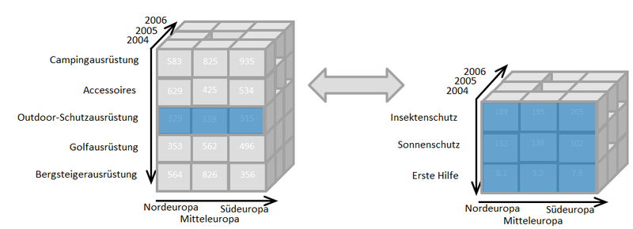
Drill-down / roll-up

Slide 11
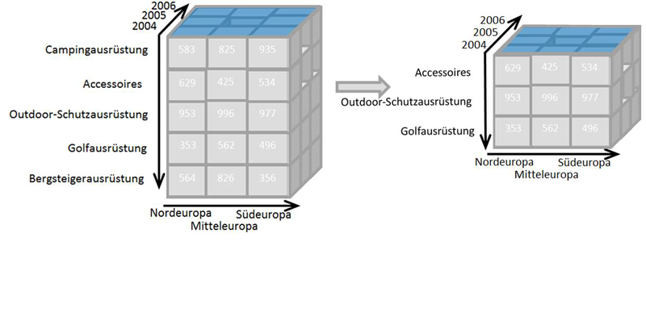
Dicing

Slide 12
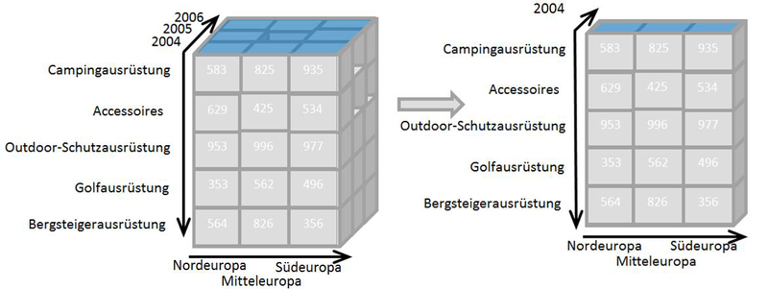
Slicing

Slide 13
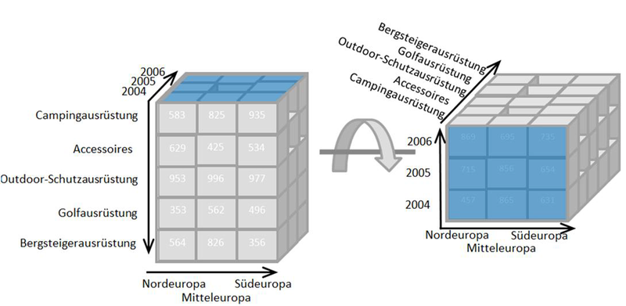
Pivoting

Slide 14
Relational set-up of OLAP
Star schema: A ”fact table”, plus a number of ”dimension tables” whose keys are foreign keys of the fact table.
Example from RG’s slides:
TIMES
timeid
date
week
month
quarter
year
holiday_flag
pid
timeid
locid
(Fact table)
sales
SALES
PRODUCTS
LOCATIONS
pid
pname
category
price
locid
city
state
country

Slide 15
Normalization in OLAP
To limit redundancy, the fact table should not have any avoidable FDs, e.g. salespersonID → shop state
The information corresponding to FDs are stored in dimension tables.
Normalize dimension tables?
Usually not.
  Unnormalized dim. tables: star schema.
  Normalized dim. tables: snowflake schema.

Slide 16
Sample OLAP query (in SQL)
SELECT SUM(S.sales)
FROM Sales S, Times T, Locations L
WHERE S.timeid=T.timeid AND S.locid=L.locid
GROUP BY T.year, L.state
Get fine-grained
aggregate data
SELECT SUM(S.sales)
FROM Sales S, Times T
WHERE S.timeid=T.timeid
GROUP BY T.year
Get dimension
”coordinates”
+aggregates
SELECT SUM(S.sales)
FROM Sales S, Location L
WHERE S.timeid=L.timeid
GROUP BY L.state

Slide 17
Special SQL OLAP syntax
Some DBMSs support special syntax for computing many aggregates.
SELECT a,b,… GROUP BY CUBE (a,b) produces a table that contains the aggregate grouped by all subets of {a,b}.
Essentially the union of
  SELECT a,b … GROUP BY a,b
  SELECT a,null,… GROUP BY a
  SELECT null,b … GROUP BY b
  SELECT null,null, …

Slide 18
OLAP challenge
Support queries fast enough to allow interactive “on-line” analytics.
Two main techniques for achieving this:
  Indexing
  Pre-aggregation
You will work with both in hand-in 4!

Slide 19
Problem session
How would you efficiently answer the query: ”Find the total sales of raincoats for each location last year.”
You may assume suitable indexes, and that timeids are ordered by time.
TIMES
timeid
date
week
month
quarter
year
holiday_flag
pid
timeid
locid
(Fact table)
sales
SALES
PRODUCTS
LOCATIONS
pid
pname
category
price
locid
city
state
country
Notes:
Covering dense indexes give access to all fact table tuples with a given time id, location id, or pid.

Slide 20
Indexing low cardinality attributes
Suppose there are only 4 different years in our previous example.
Then we may represent the locations of N fact table tuples using only 2N bits.
However, an (unclustered) index on location seems to require at least
N log N bits.
If reading data is the bottleneck, can we get by reading less data?

Slide 21
Basic bitmap index
For each possible value (of ”year”) and each tuple, store a bit that is 1 iff the tuple contains the given value.
Store these bits ordered
by column (with no RID).
The bitmap index works
as a join index that can
be used to compute joins
using RID intersection.
Y1? | Y2? | Y3? | Y4? | RID
0 | 0 | 1 | 0 | 1
1 | 0 | 0 | 0 | 2
1 | 0 | 0 | 0 | 3
0 | 1 | 0 | 0 | 4
0 | 0 | 0 | 1 | 5

Slide 22
Gain of bitmap indexes
Assume bottleneck is reading data.
How much can at most be gained by using bitmap indexes to do a star join (with a selection on each dimension table), compared to using a B-tree?
  Theoretically 1 bit/tuple vs log N bits/tuple.
  Typically 1 bit/tuple vs 32 bits/tuple.
Main case where there is no gain:
  A single dimension is very selective.
  (Usually only the case for high cardinality attributes.)

Slide 23
Compressed bitmap indexes
If there are many possible values for an attribute (it has ”high cardinality”), basic bitmap indexing is not space efficient (nor time efficient).
Observation: A column will have few 1s, on average. It should be possible to ”compress” long sequences of 0s.
How to compress? Usual compression algorithms consume too much computation time. Need simpler approach.

Slide 24
Word-aligned hybrid (WAH) coding
[WOS04]
In a nutshell:
  Split the bitmap B into pieces of 31 bits.
  A 32-bit word in the encoding contains one of the following, depending on the value of its first bit:
    A number specifying the length of an interval of bits where all bits of B are zeros.
    A piece of B (31 bits).
  The conjunction (”AND”) or disjunction (”OR”) of two compressed bitmaps can be computed in linear time (O(1) ops/word).

Slide 25
WAH analysis
Let N be the number of rows of the indexed relation, and c the cardinality of the indexed attribute.
At most N WAH words will encode a piece of the bitmap.
Reasonable assumption:
  All (or most) gaps between consecutive 1s can be encoded using 31 bits.
  Thus, at most N+c gaps.
Total space usage: 2N+c words.
Compares favorably to B-trees.
Notes:
Compared against DBMS not using a bitmap index (MySQL): Speedup several orders of magnitude.

Slide 26
Bitmap index support
MySQL: Not supported – analytics is not an important market segment.
  However, supports index intersection.
Oracle:
CREATE BITMAP INDEX ON sales(pid)
  Internal representation is another compressed bitmap format (BBC).
Some non-relational systems like FastBit work entirely with compressed bitmap representations of sets.
Notes:
Check tip!

Slide 27
Pre-aggregation
Idea: Precompute certain aggregates that can be used to answer queries quickly.
Example:
  Precompute the number of sales and average sales price for each dealer.
  Allows us to quickly find e.g. the number of sales for each country.
Wanted:
Database support for keeping track of suitable preaggregated values.

Slide 28
Materialized views
Recall: A view is similar to a macro.
CREATE VIEW MyView AS
SELECT *
FROM Sales S, Times T, Locations L
WHERE S.timeid=T.timeid AND
S.locid=L.locid
In contrast, a materialized view physically stores the query result.
  Can be updated automatically
  Can be indexed!
Notes:
Philosophical note: Does not need to be represented the same way as a table. Apptus point of not mixing abstract view with implementation.

Slide 29
Preaggregation with materialized view
Materialized view is created:
CREATE MATERIALIZED VIEW SalaryByLocation AS
SELECT location_id, country_id, SUM(salary) AS s
FROM Employees NATURAL JOIN Departments
NATURAL JOIN Locations
GROUP BY location_id, country_id
Materialized view is used:
SELECT country_id, SUM(salary) AS salary
FROM SalaryByLocation
GROUP BY country_id
Factor 10 faster than direct query on Oracle XEs example DB.

Slide 30
Automatically using mat. views
Suppose a user does not know about the materialized view and writes directly
SELECT location_id, country_id, SUM(salary) AS s
FROM Employees NATURAL JOIN Departments
NATURAL JOIN Locations
GROUP BY country_id
A smart (expensive) DBMS will realize that this can be rewritten to a query on the materialized view.
Rewrite capability is a key technique in relational OLAP systems.

Slide 31
Materialized views in MySQL
Not supported...
However, can be emulated by creating tables, i.e., CREATE MATERIALIZED VIEW becomes CREATE TABLE.
Main differences:
  No automatic updates.
  No automatic query rewrite.

Slide 32
”Refreshing” a materialized view
Any change to the underlying tables may give rise to a change in the materialized view. There are at least three options:
  Update for every change (”ON COMMIT”)
  Update only on request (”ON DEMAND”)
  Update when the view is accessed (”lazy”)
RG describes a way of refreshing where recomputing the defining query is often not necessary (”FAST”).

Slide 33
On-line aggregation
For aggregates like sums and averages, the result on a sample can be used to estimate the result on all data.
  Same principle as used in opinion polls!
Can give statistical guarantees on an answer, e.g. ”Answer is 3200±180 with 95% probability”.
  The longer the query runs, the smaller the uncertainty gets.
  Possibly ok to terminate before precise answer is known.
Research area: Do on stream of data.

Slide 34
Next steps
Did you fill out the course evaluation?
Exercises:
  Work on hand-in 3 (individual), and/or
  Work on hand-in 4 (groups)
Next week: Guest lecture by Kennie Nybo Pontoppidan from Rehfeld.
  Abstract: How do you design a data warehouse for the handling of management information in seven subject areas for all 98 municipalities in Denmark? Especially when there exists up to five different IT systems per field, and that the municipalities can use the systems differently. Add to this a requirement to change the business rules for each municipality, and the ability to report on one municipality, while data for another municipality is updated. The size of the data warehouse will be in the order of 8TB in production.

